Slide 1

Carbon Dioxide Emissions Shiny App
By Kristine Mitchell
DATA 824
Summer 2022

Slide 2
Dataset #1
1. Greenhouse gas emissions around the world from 1750 to 2020
From “Our World in Data” site (see sources slide)
Data set includes the different sources of greenhouse gas emissions, broken down by fuel source
Some countries have estimated data as far back as 1750
In recent years, total greenhouse gas emissions broken down by methane and nitrous oxide are included
Includes per capita breakdown for each, as well as the country’s annual global contribution for that gas
Includes population and GDP for the country for each year
Notes:
Did the presentation tell us what the data were and why they were interesting?
Was the dataset sufficiently complex and interesting enough to justify its use?
What to expect from it?
Where the data comes from?
Did the visualizations or tool created allow for interesting insight into the data?
Did the visualizations adhere to the principles?
Were violations of the principles warranted?
Did the presentation give us an interesting/compelling story about the data?

Slide 3
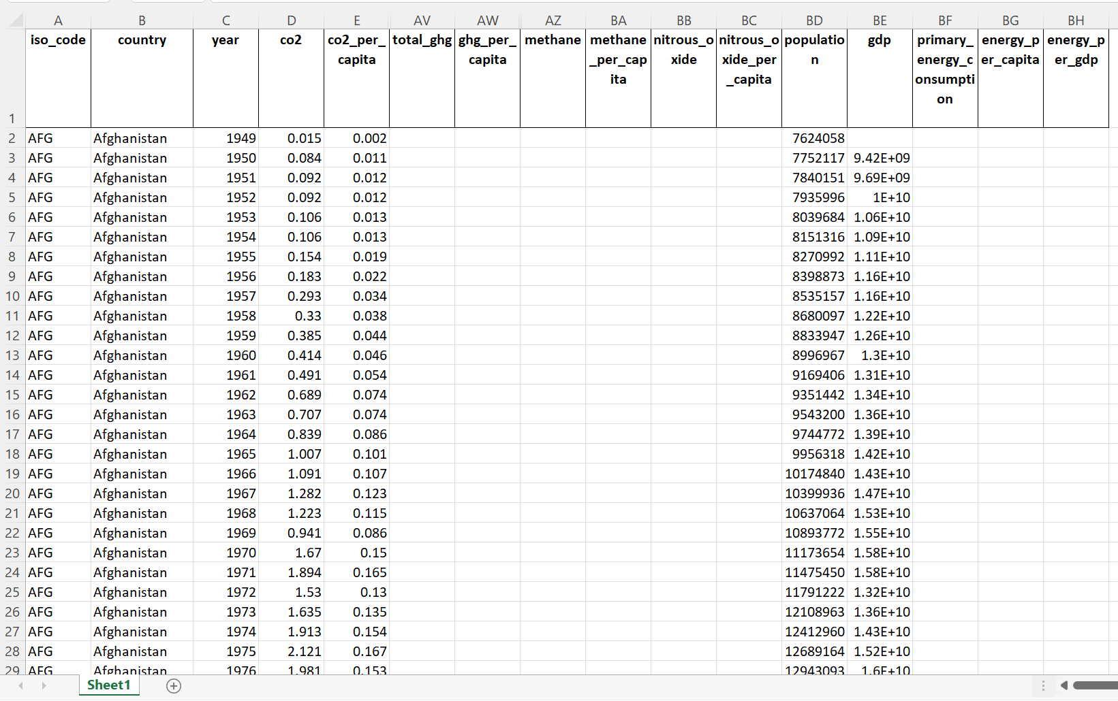
Dataset #1
Greenhouse gas emissions around the world from 1750 to 2020
Raw data from source
Notes:
Did the presentation tell us what the data were and why they were interesting?
Was the dataset sufficiently complex and interesting enough to justify its use?
What to expect from it?
Where the data comes from?
Did the visualizations or tool created allow for interesting insight into the data?
Did the visualizations adhere to the principles?
Were violations of the principles warranted?
Did the presentation give us an interesting/compelling story about the data?

Slide 4
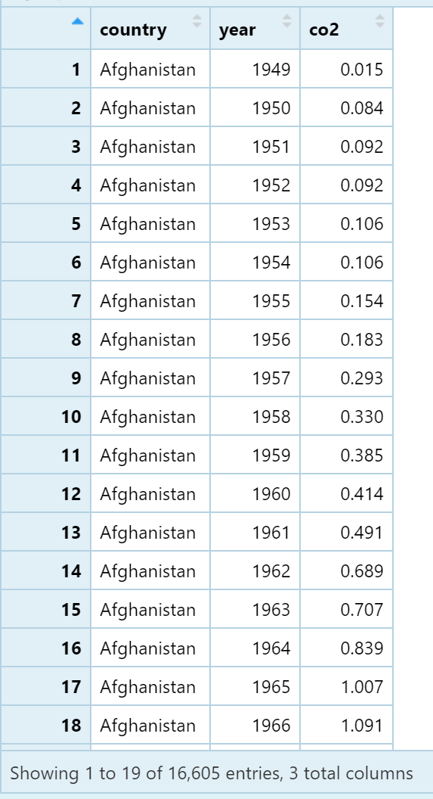
Dataset #1
Greenhouse gas emissions around the world from 1750 to 2020
Data imported into R
Notes:
Did the presentation tell us what the data were and why they were interesting?
Was the dataset sufficiently complex and interesting enough to justify its use?
What to expect from it?
Where the data comes from?
Did the visualizations or tool created allow for interesting insight into the data?
Did the visualizations adhere to the principles?
Were violations of the principles warranted?
Did the presentation give us an interesting/compelling story about the data?

Slide 5
Dataset #2
2. Global Temperature Anomalies from 1880 to 2021
From NASA (see sources slide)
Includes monthly average ambient temperatures
Data collected over both land and ocean
Temperature is given as an anomaly compared to a baseline from 1951-1980 (see NASA website for more information), so it’s not given in absolute temperatures
Notes:
Did the presentation tell us what the data were and why they were interesting?
Was the dataset sufficiently complex and interesting enough to justify its use?
What to expect from it?
Where the data comes from?
Did the visualizations or tool created allow for interesting insight into the data?
Did the visualizations adhere to the principles?
Were violations of the principles warranted?
Did the presentation give us an interesting/compelling story about the data?

Slide 6
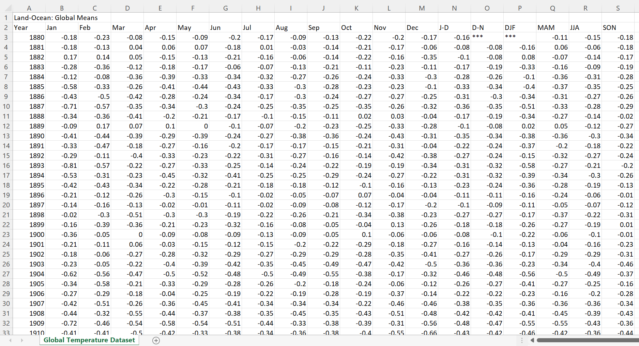
Dataset #2
Global Temperature Anomalies from 1880 to 2021
Raw data from source
Notes:
Did the presentation tell us what the data were and why they were interesting?
Was the dataset sufficiently complex and interesting enough to justify its use?
What to expect from it?
Where the data comes from?
Did the visualizations or tool created allow for interesting insight into the data?
Did the visualizations adhere to the principles?
Were violations of the principles warranted?
Did the presentation give us an interesting/compelling story about the data?

Slide 7
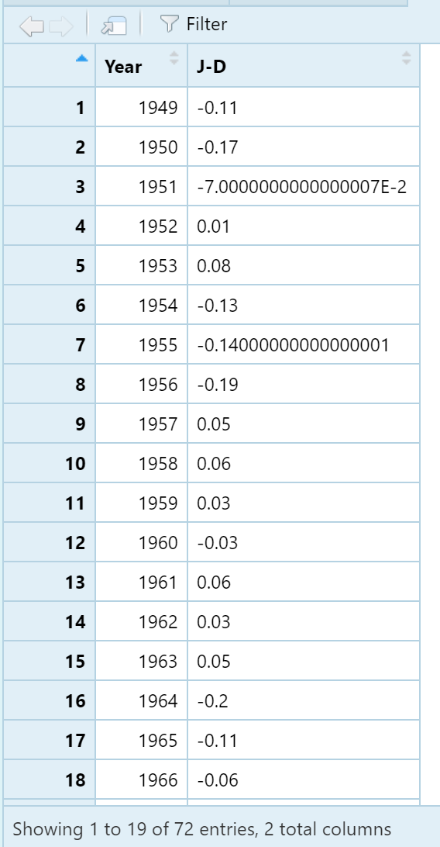
Dataset #2
Global Temperature Anomalies from 1880 to 2021
Data imported into R
Notes:
Did the presentation tell us what the data were and why they were interesting?
Was the dataset sufficiently complex and interesting enough to justify its use?
What to expect from it?
Where the data comes from?
Did the visualizations or tool created allow for interesting insight into the data?
Did the visualizations adhere to the principles?
Were violations of the principles warranted?
Did the presentation give us an interesting/compelling story about the data?

Slide 8
Data Wrangling
From Dataset #1, I chose to use the CO2 values for years 1949 through 2020.
I averaged all CO2 values for each country per year using R Programming and converting the data from long to wide format.
From Dataset #2, I chose to use the average temperature anomaly for each year from the January through December information and using the same range of years as Dataset #1 (1949 through 2020).
I combined these three columns into a new data frame to use for my shiny app.

Slide 9
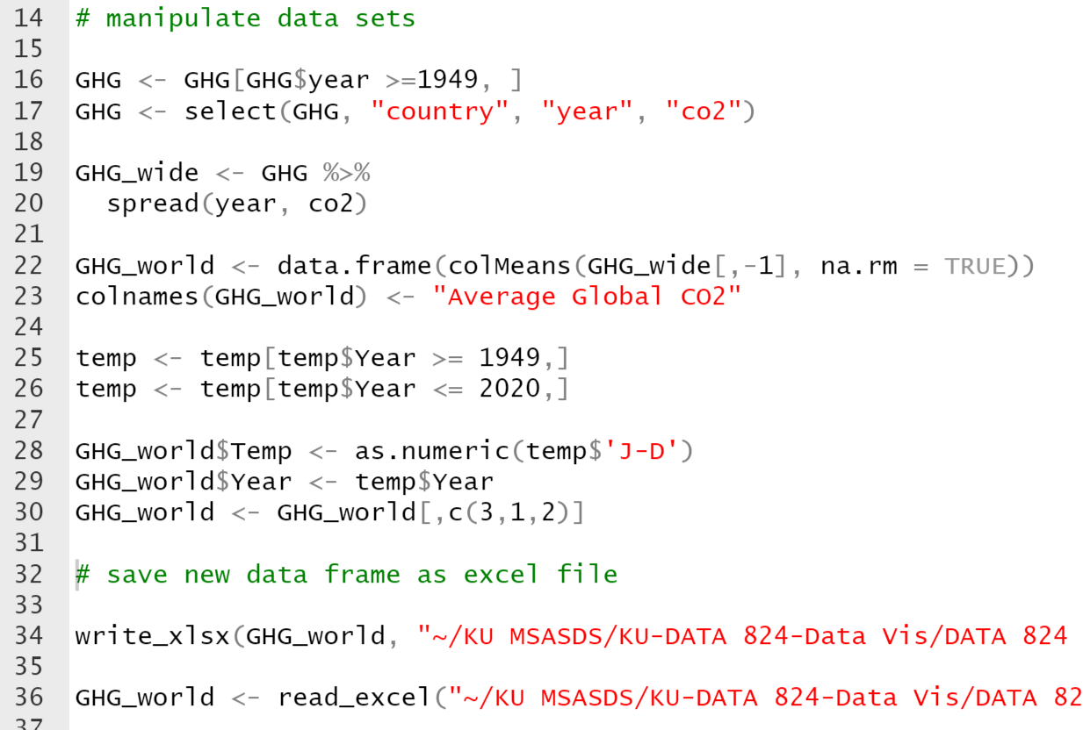
Data Wrangling
See “final script help.R” document for the script used for data wrangling

Slide 10
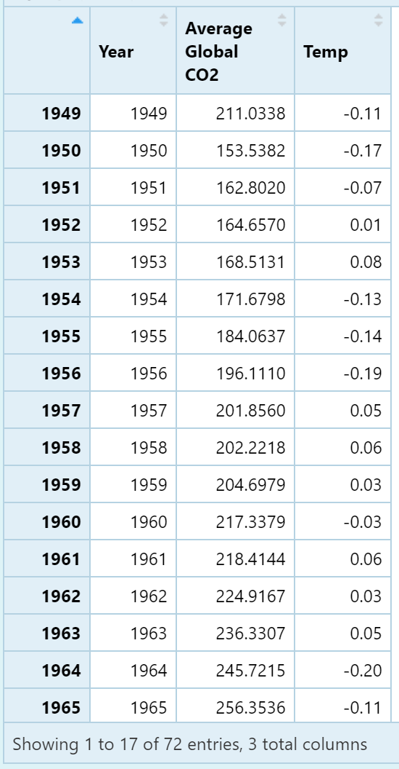
Data Wrangling
Greenhouse gas emissions around the world from 1750 to 2020
Global Temperature Anomalies from 1880 to 2021
Data frame used in Shiny App

Slide 11
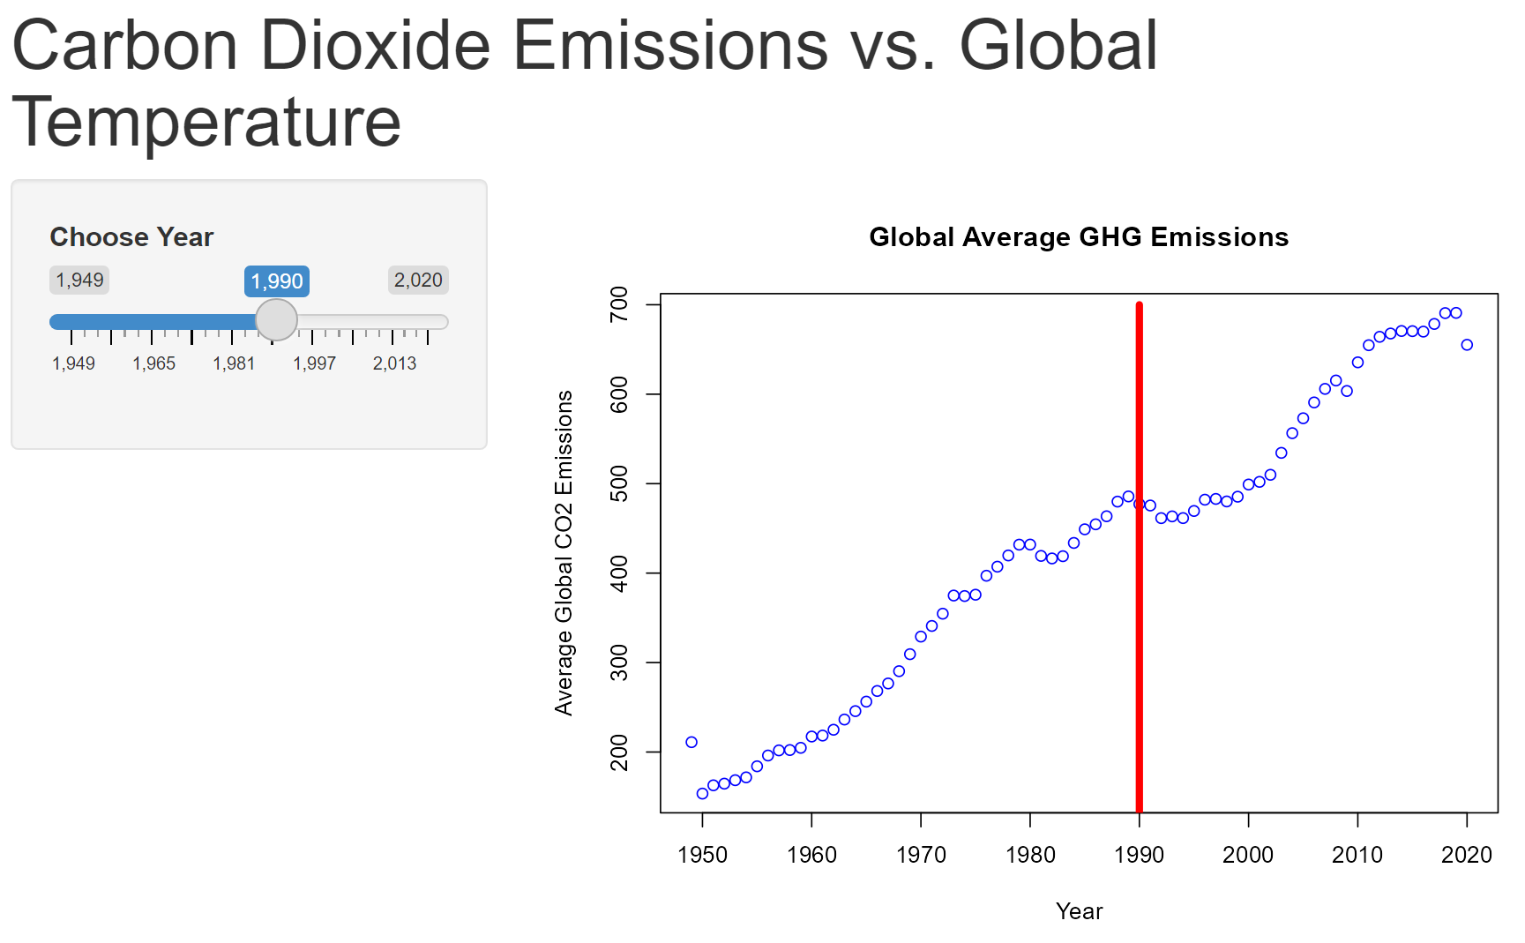
Shiny App
I chose to create a Shiny R App where the user could choose the year on a slider and a line on the graph would show the average CO2 emissions for that year and the temperature anomaly associated with it.

Slide 12
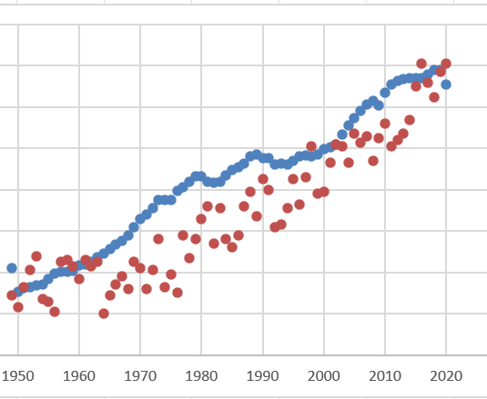
Insights
The final Shiny App is intended to provide the user with insights into the association between average carbon dioxide emissions and global temperature anomaly (change from baseline)
As CO2 emissions increase, global temperature anomaly
Notes:
Did the presentation tell us what the data were and why they were interesting?
Was the dataset sufficiently complex and interesting enough to justify its use?
What to expect from it?
Where the data comes from?
Did the visualizations or tool created allow for interesting insight into the data?
Did the visualizations adhere to the principles?
Were violations of the principles warranted?
Did the presentation give us an interesting/compelling story about the data?

Slide 13
GitHub Repository
The files associated with this project are located on GitHub at the following link / repository:
https://github.com/krismitch/DATA-824-Final

Slide 14
Sources
Datasets:
1. Greenhouse gas emissions
Site: https://ourworldindata.org/co2-and-other-greenhouse-gas-emissions
2. Global Temperature Anomalies
Site: https://data.giss.nasa.gov/gistemp/

